Slide 1
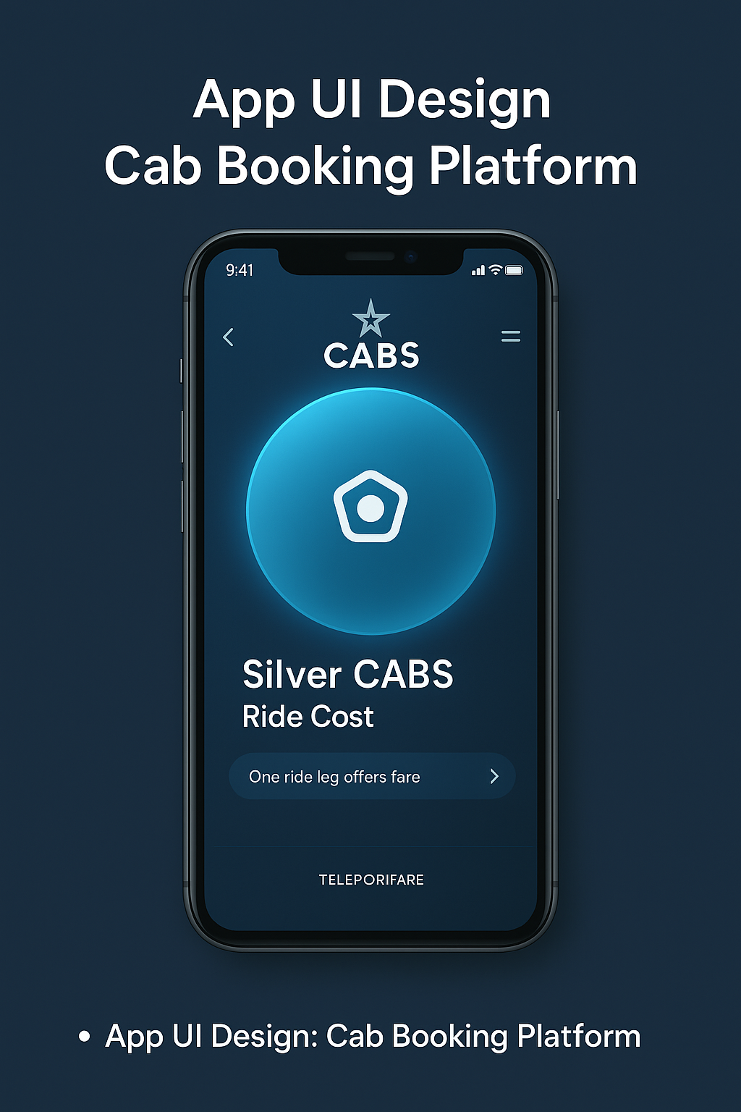

Revolutionizing Local Transportation: Ride-Hailing Platform
Bringing local cabs into the digital era. By: Keawin Koesnel & Team.
by Keawin Koesnel

Slide 2




The Current Challenge
Digital Divide
Limited Access
Many local cab drivers aren't digitally connected.
Customers struggle to access safe, reliable transport.
Welfare Overlooked
Driver welfare and safety often overlooked.

Slide 3

Our Vision
Empower Drivers
Provide Affordable Rides
Foster Growth
Equip local cab companies with digital tools.
Offer secure, accessible rides to users.
Keep revenue local, boosting community economies.

Slide 4
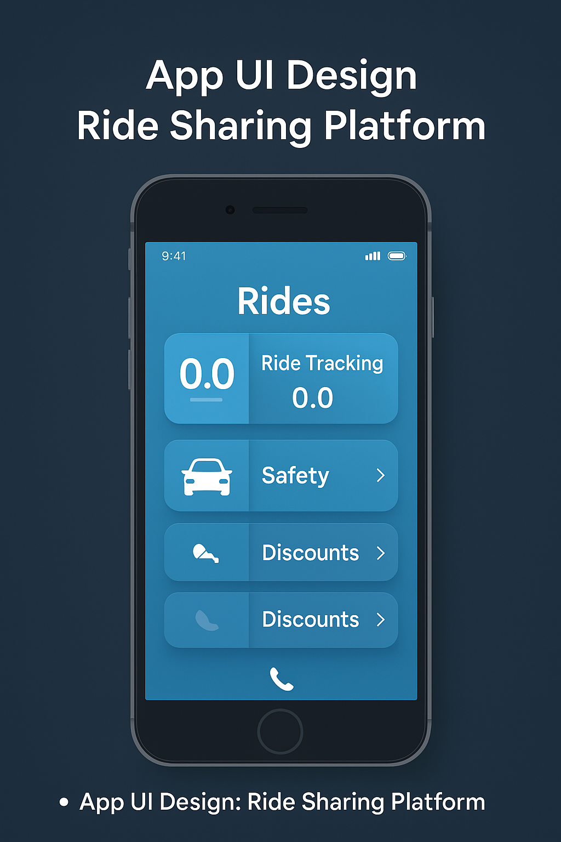




Key Features
Hazard Pay
Security Suite
Telephonic Booking
Rewards drivers in high-risk areas.
Emergency alerts and location tracking.
For users without smartphones.
Discount Models
For students, pensioners, and workers.

Slide 5





How It Works
Book Ride
Riders book via app or phone.
Accept Request
Local cabs receive and accept trips.
Dynamic Pricing
Transparent, dynamic pricing system.
Ratings
Improve quality and accountability.

Slide 6
Target Market
Local Commuters
Small Cab Businesses
Vulnerable Groups
Tourists
In underserved regions of South Africa.
Seeking digital transformation.
Needing safe, affordable transport.
Occasional riders.

Slide 7



Business Model
Subscription
2
Monthly for premium cabs.
Commission
1
Low rate per ride.
3
Ads & Promos
Diversify revenue streams.

Slide 8
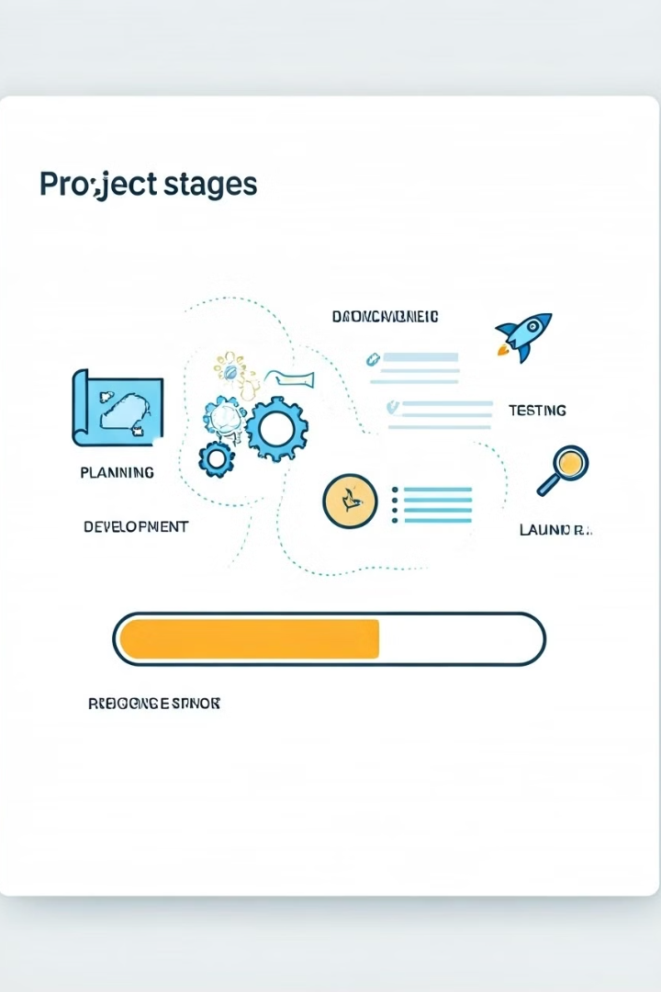
Progress & Roadmap
1
Planning
Project planning complete.
2
Mockups
Initial mockups built.
3
MVP
Minimum Viable Product in development.
4
Pilot
Reaching out to local cab partners.

